Slide 1

documentation OF - Online Money receipt (OMR)
Prepared By :
Tonmoy Rudra
(Executive It Development)

Slide 2
Online Money Receipt – (OMR) - Flow
OMR System – Create MR & Application
Yes
Yes
Oracle Process
Create Money Receipt (MR)
MR Approval
Unapplied CM
Unapplied MR
Apply With Different Org.
Apply With Same Org.
Apply With Different Org.
Application
Adjustment
AIT
Nor-AIT
Write Off
New ICT CM
New ICT MR
Reserve AIT Amount
Apply amount after deducting AIT Amount
Unapplied AIT MR
Apply

Slide 3
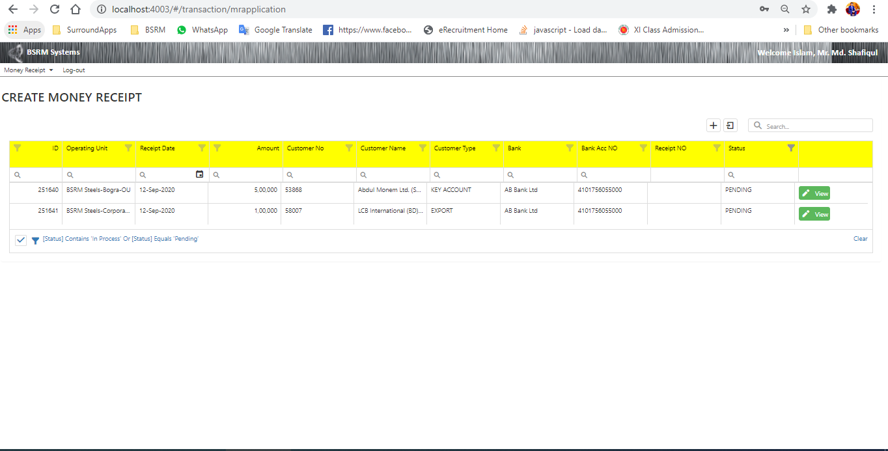
Money Receipt (MR) – Get Pending MR
Description: Get all pending MR list by user
API Method: GET
ApiEndpoint: bsrmapi/MRApplication (type:3)
Table/View: MR_ONLINE_REQUEST_V

Slide 4
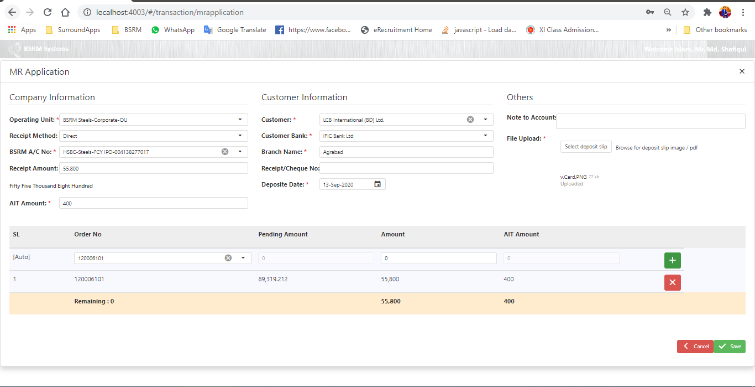
Money Receipt (MR) – Create MR
Description: Create a new MR
API Method: POST
ApiEndpoint: bsrmapi/MRApplication
Table/View: MR_ONLINE_REQUEST, MR_ONLINE_REQUEST_LINES (Details)

Slide 5
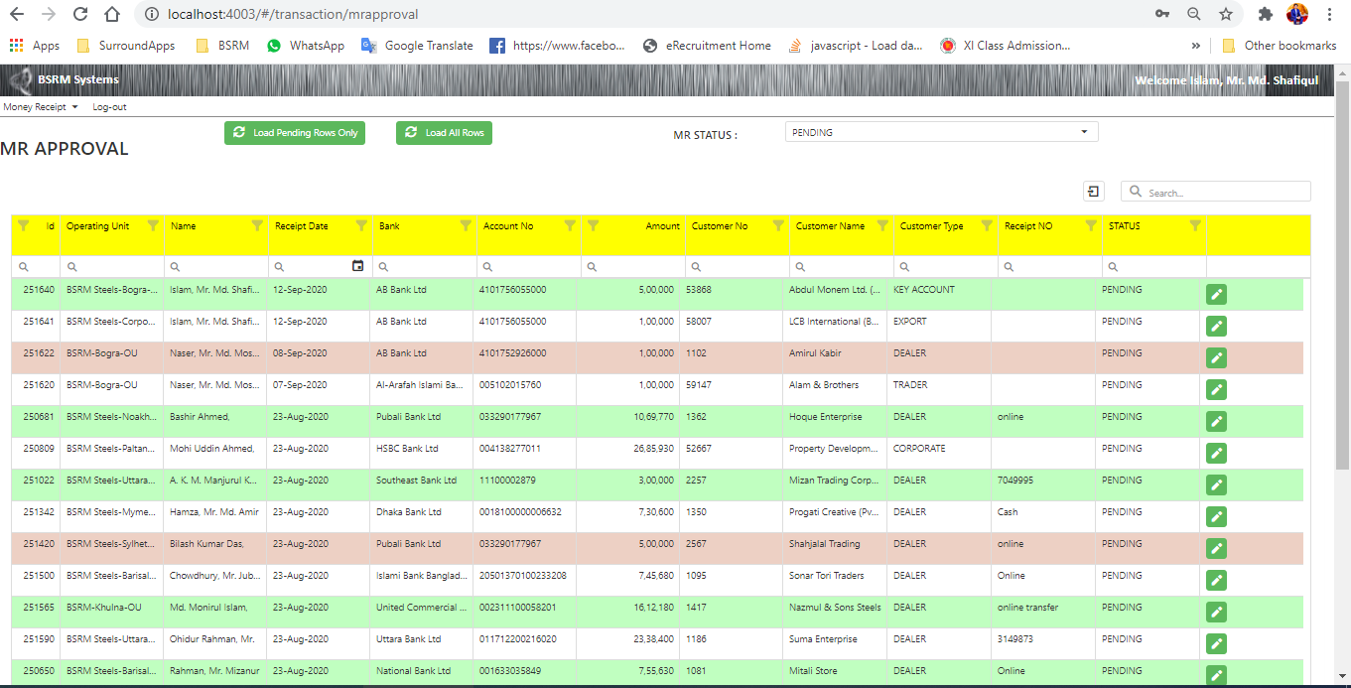
MR Approval – Get Pending MR List
Description: Get all pending MR List
API Method: GET
ApiEndpoint: bsrmapi/MRApproval (type:3)
Table/View: MR_ONLINE_REQUEST_V

Slide 6
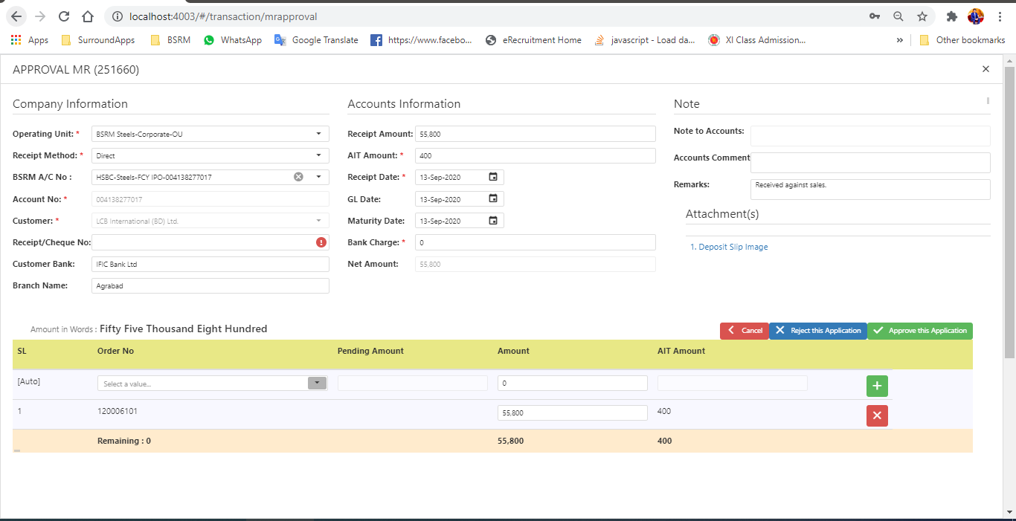
MR Approval
Description: Approve MR by respective person from accounts.
API Method: POST
ApiEndpoint: bsrmapi/MRApproval
Table/View: MR_ONLINE_REQUEST_LINES
Proce: CreateMR_FromOnline

Slide 7
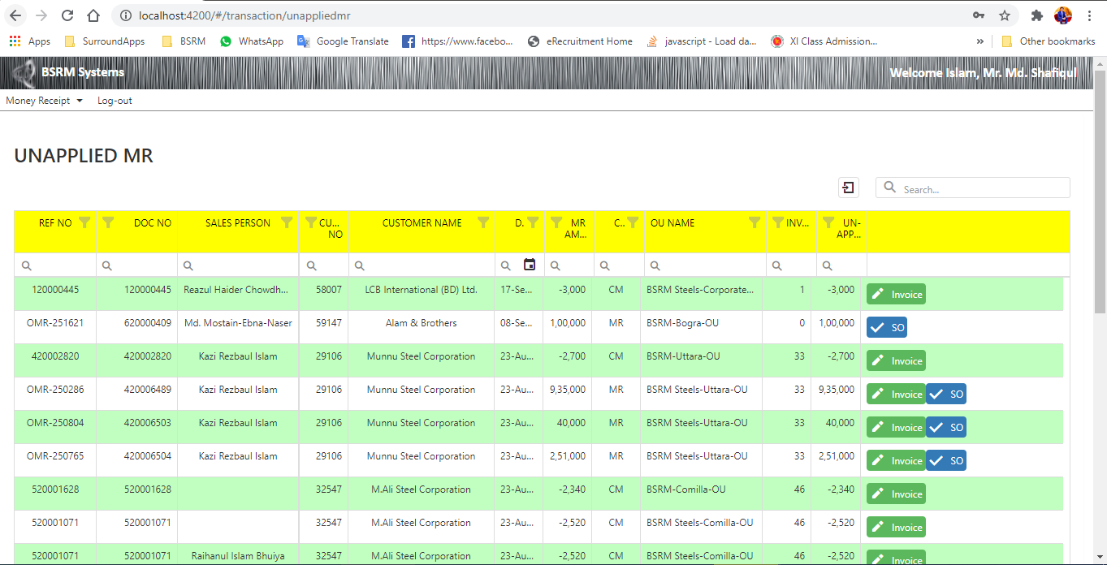
Unapplied MR
Description: Get all unapplied MR List
API Method: GET
ApiEndpoint: bsrmapi/UnAppliedMR (type 0)
Table/View: MR_UNAPPLIED_MR_CM_V
Proce. MR_AGING_INTEGRATION_PKG.Apply_LinesWithMR
Note: CM – Applied with Invoice and MR – Applied with Invoice & SO both

Slide 8
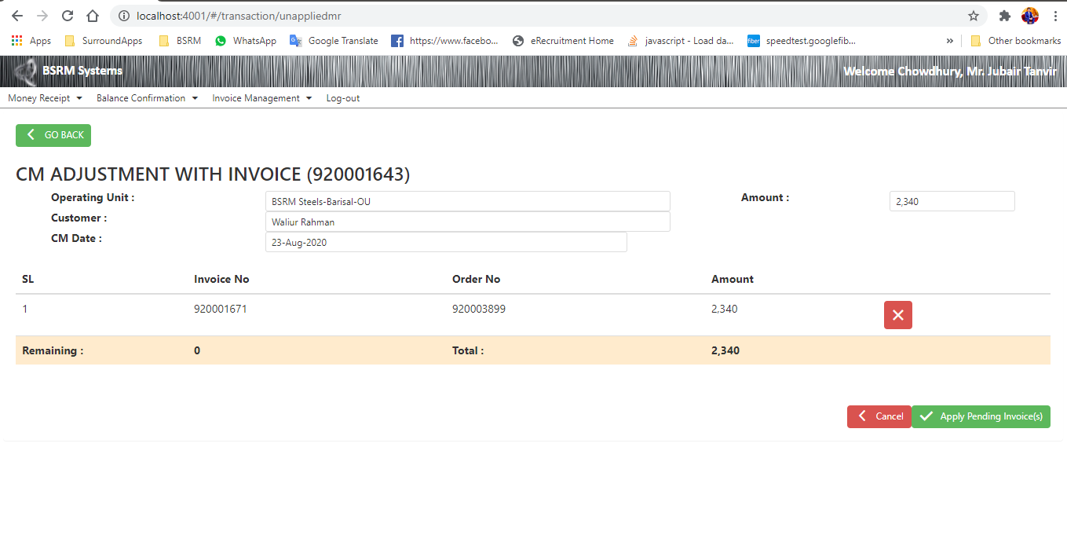
Unapplied MR – Apply Pending Invoice For CM
Description: Apply Pending Invoice for CM
API Method: POST
ApiEndpoint: bsrmapi/UnAppliedMR
Table/View: MR_UNAPPLIED_MR_CM_V
Proce.: MR_AGING_INTEGRATION_PKG.APPLY_CM
Flow:
If (RECEPT_METHOD_GROUP == "CM“) than,
1st check if any MR applied on last 45 min,
Then apply new lines on MR_APPLIED_CM_LINES table and
Then finally call e Procedure ‘MR_AGING_INTEGRATION_PKG.APPLY_CM’

Slide 9
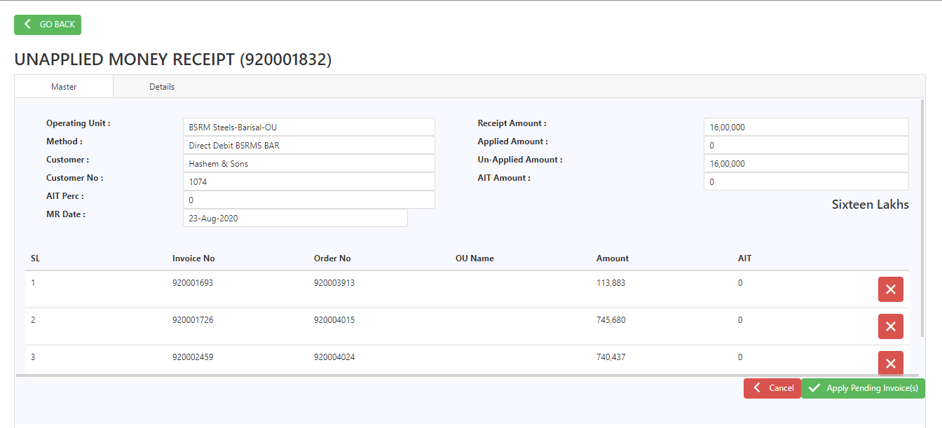
Unapplied MR – Apply Pending Invoice For MR
Description: Apply Pending Invoice for MR
API Method: POST
ApiEndpoint: bsrmapi/UnAppliedMR
Table/View:
For Master → MR_ONLINE_REQUEST
For Details → MR_ONLINE_APPLIED_LINES
Proce.:MR_AGING_INTEGRATION_PKG.Apply_LinesWithMR
Flow:
If (RECEPT_METHOD_GROUP != "CM“) than,
1st check if any MR applied on last 45 min,
Then add Master data on MR_ONLINE_REQUEST table and details on MR_ONLINE_APPLIED_LINES.
Then finally call e Procedure ‘MR_AGING_INTEGRATION_PKG.Apply_LinesWithMR’

Slide 10
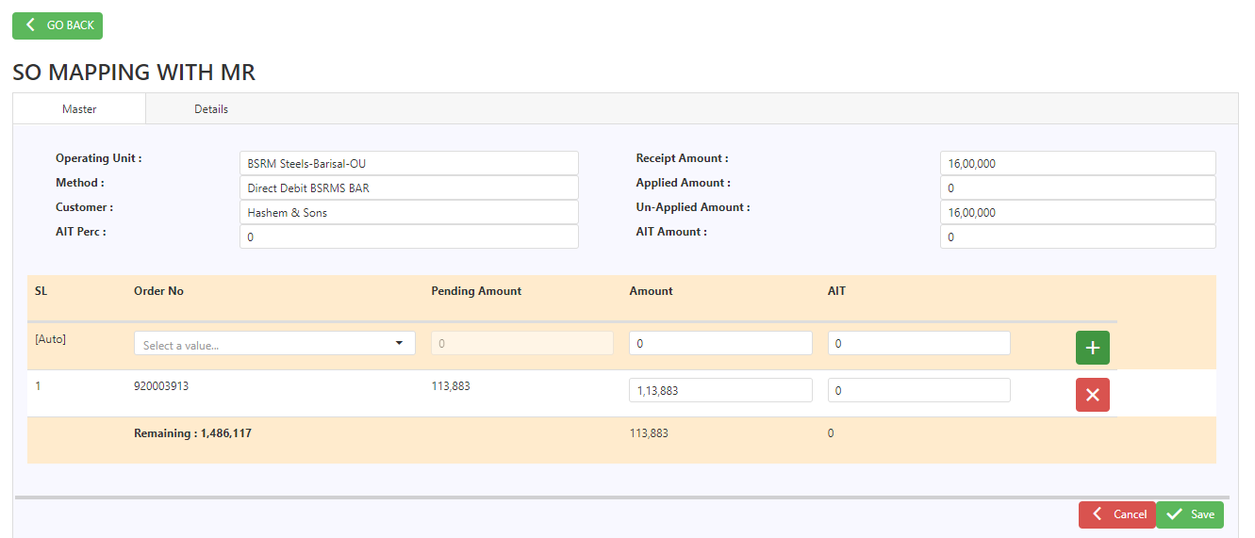
Unapplied MR – Apply Pending Sales Order (SO) For MR
Description: Apply Pending sales order for MR
API Method: POST
ApiEndpoint: bsrmapi/UnAppliedMRSO
Table/View:
For Master → MR_ONLINE_REQUEST
For Details → MR_ONLINE_APPLIED_LINES
Proce.:MR_AGING_INTEGRATION_PKG. PROCESS_SINGLE_MR
Flow:
If (RECEPT_METHOD_GROUP != "CM“) than,
1st check if any MR applied on last 45 min,
Then add Master data on MR_ONLINE_REQUEST table and details on MR_ONLINE_APPLIED_LINES.
Then finally call e Procedure ‘MR_AGING_INTEGRATION_PKG. PROCESS_SINGLE_MR’

Slide 11
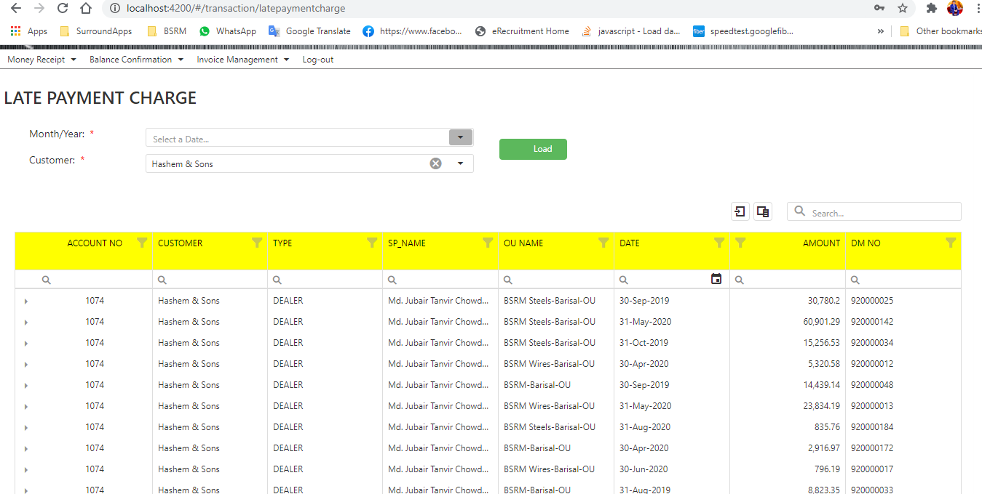
Late Payment Charge (LPC)
Description: Get all list which customer are applicable for LPC. Filter by Month, Year, Customer
API Method: GET
ApiEndpoint: bsrmapi/MRInterestCalculation
Table/View: MR_INTEREST_AMOUNT_LIST, MR_INTEREST_INVOICE,
Flow:
There are 2 logic,
If (user_type == sp && sp_role != support) {}
else {}

Slide 12
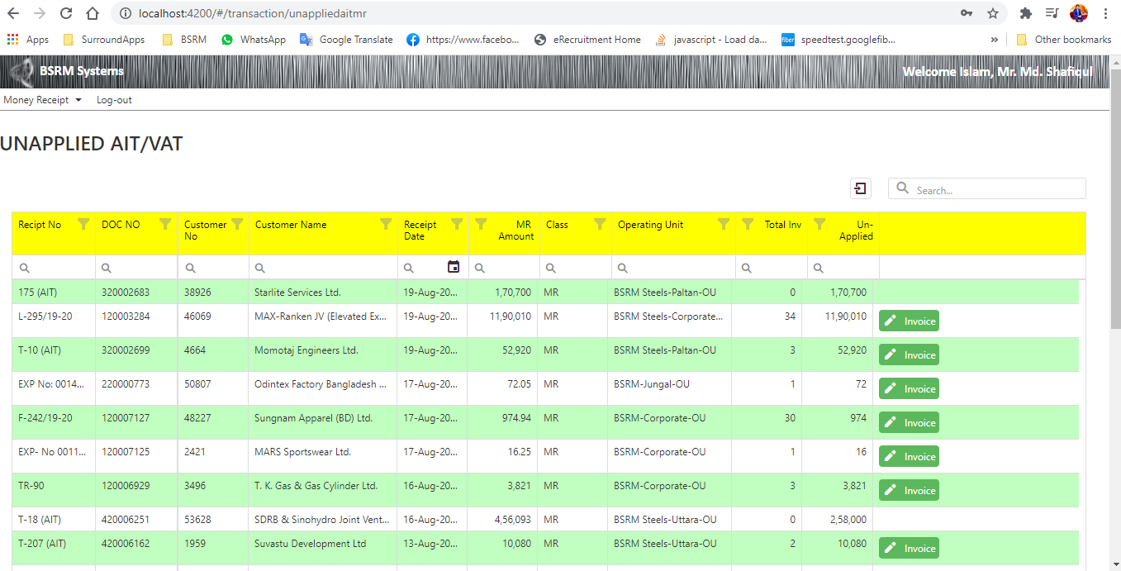
Unapplied AIT/VAT
Description: Get all AIT and VAT list.
API Method: GET
ApiEndpoint: bsrmapi/UnAppliedAitMR
Table/View: APPS.MR_AIT_UNAPPLIED_SP_BSRM_V
Flow:
There are 2 logic,
If (user_type == sp && sp_role != support) {}
else {}

Slide 13
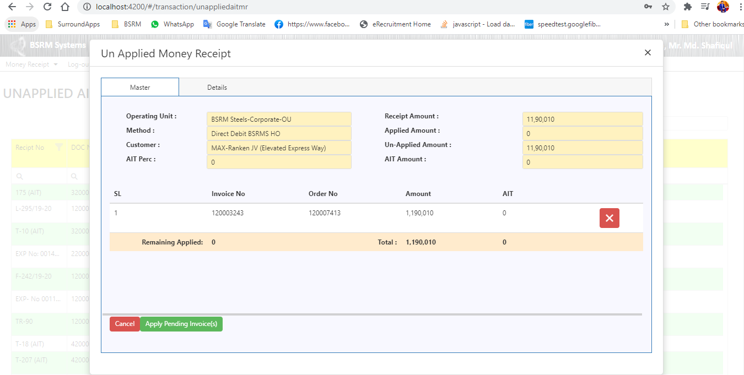
Unapplied AIT/VAT
Description: Apply Pending AIT/VAT with MR
API Method: POST
ApiEndpoint: bsrmapi/MRInterestCalculation
Table/View:
For Master → MR_ONLINE_REQUEST
For Details → MR_ONLINE_APPLIED_LINES
Proce.: MR_AGING_INTEGRATION_PKG.Apply_LinesWithMR
Flow:
If (RECEPT_METHOD_GROUP != "CM“) than,
1st check if any MR applied on last 45 min,
Then add Master data on MR_ONLINE_REQUEST table and details on MR_ONLINE_APPLIED_LINES.
Then finally call e Procedure ‘MR_AGING_INTEGRATION_PKG.Apply_LinesWithMR’

Slide 14
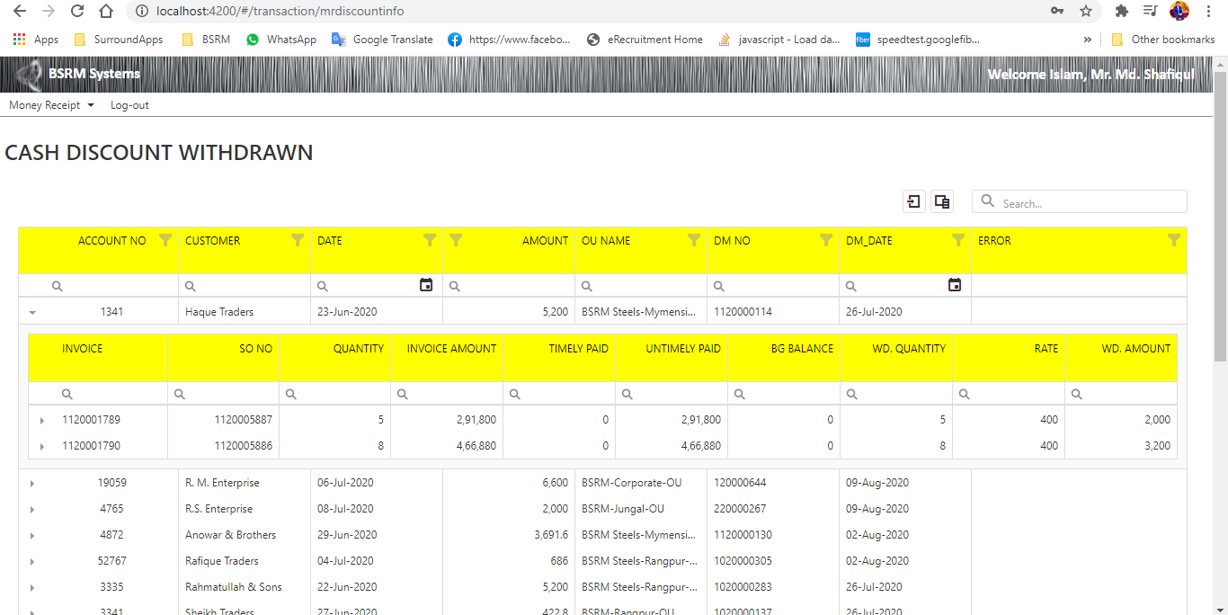
Cash Discount Withdrawn
Description: Get All Cash Discount Withdrawn Customer list
API Method: GET
ApiEndpoint: bsrmapi/MRDiscountInformation
Table/View: MR_DISCOUNT_WITHDRAW
Proce.:

Slide 15
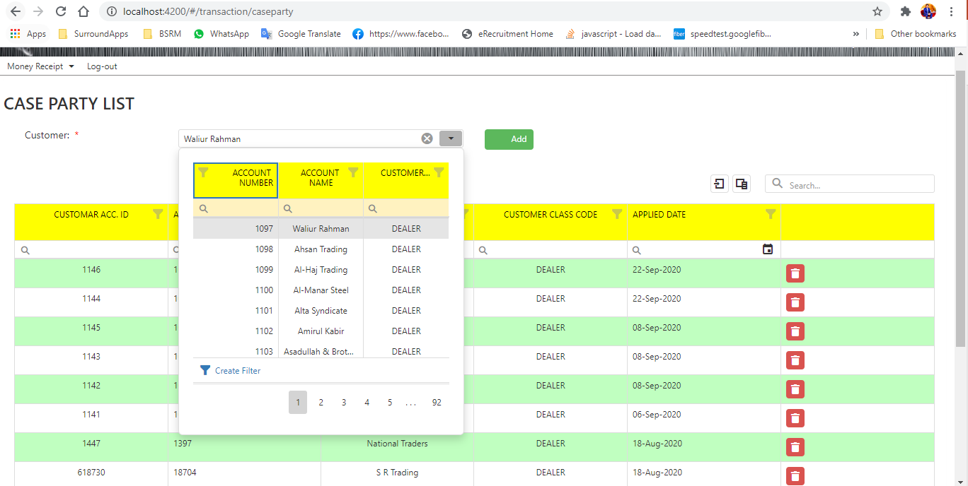
Case Party
Description: Get all case party list
API Method: GET
ApiEndpoint: bsrmapi/CaseParty
Table/View: Mr_Case_Customer_List
Description: Add a customer on that list.
API Method: POST
ApiEndpoint: bsrmapi/CaseParty
Table/View: Mr_Case_Customer_List

Slide 16
THANK YOU

